Slide 1
High Speed Ball Tracking For Analytics In
Table Tennis Using Open-CV From Video Feed
For Use In Sports Analytics

Slide 2

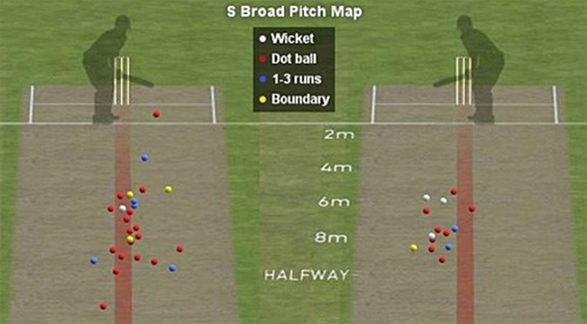
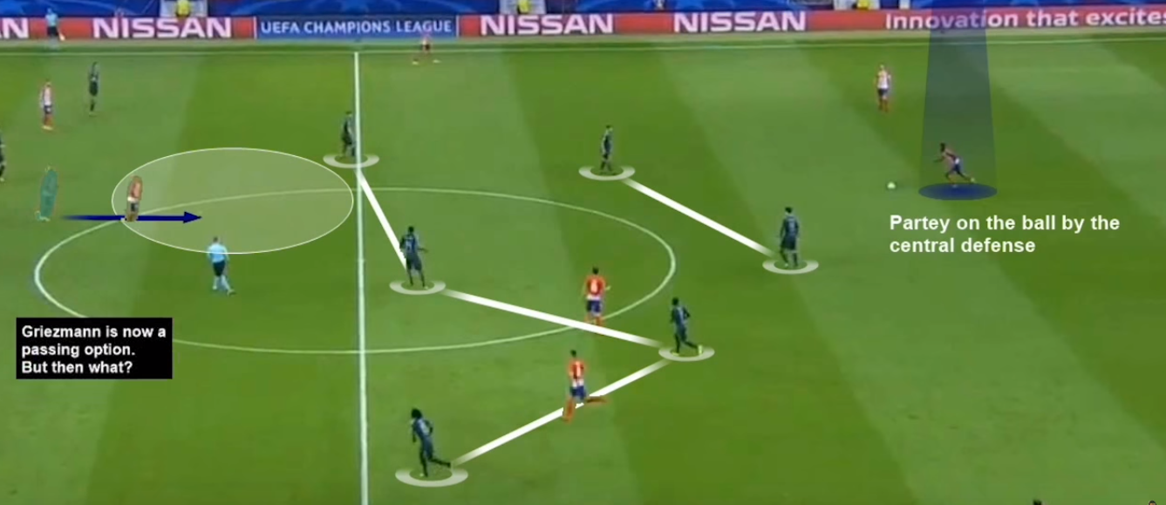
Introduction to Sports Analytics
The use of historic player and gameplay data for analysis and improvement of strategy in future games is known as Sports Analytics.
Use of object recognition to analyse bowling strategy to different batsmen
Use of probabilistic analysis to determine passing strategy in football.

Slide 3
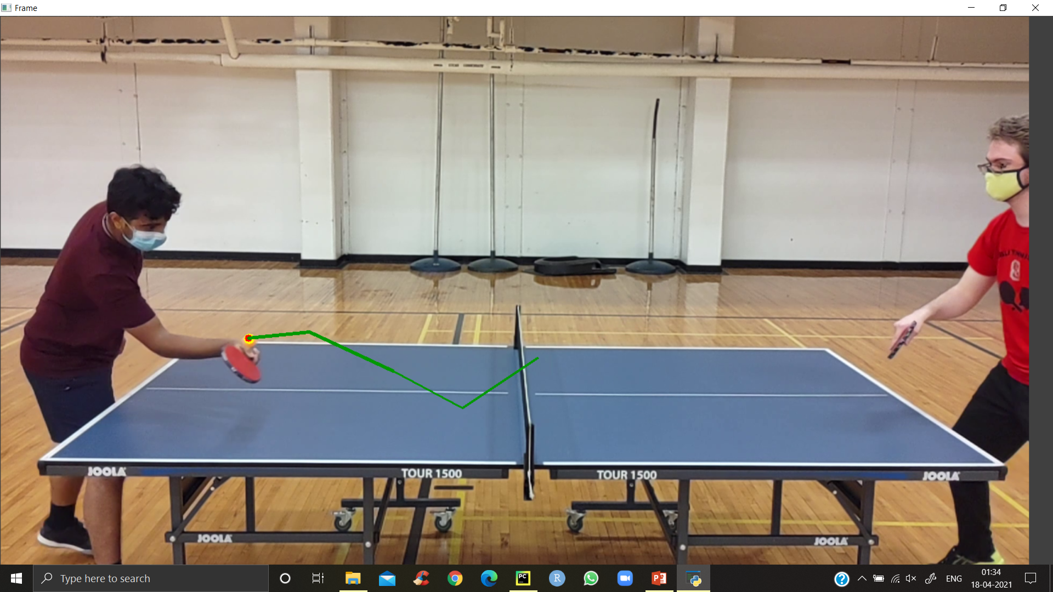
Objectives and Challenges
OBJECTIVES
Real-time processing of high resolution table tennis videos
Processing of high resolution table tennis match recordings
Events spotting (ball bounces and net touches).
Ball detection.
CHALLENGES
Sample frame with the Ball Tracking overlaid
The size of the ball in a full HD video is quite small (about 15 pixels on average)
The ball may be not the only small white object in the image because of the parts of player
clothing or background elements.
The ball speed May be more than 20m/s (apprx 70 km/h)
Video data with a high frame rate is required to detect the trajectory of the ball and corresponding events.

Slide 4
Methodology – Step 1: Capturing Video
Since the Problem Deals with Video processing from both live feed as well as from recorded videos the following procedures were followed:
Standardized Height of camera placement.
Distance from table corners to be standardized.
The only variable would be the type of camera used (Video Resolution, Frame rate, Color Space, Focal length)
Camera Set to 31mm on a 1.6 crop factor to achieve 50mm Focal length
1370 mm
2650 mm
1710 mm
FOV
FOV
2650 mm
Camera Setup with FOV – Top View
Camera Setup with FOV – Side View

Slide 5
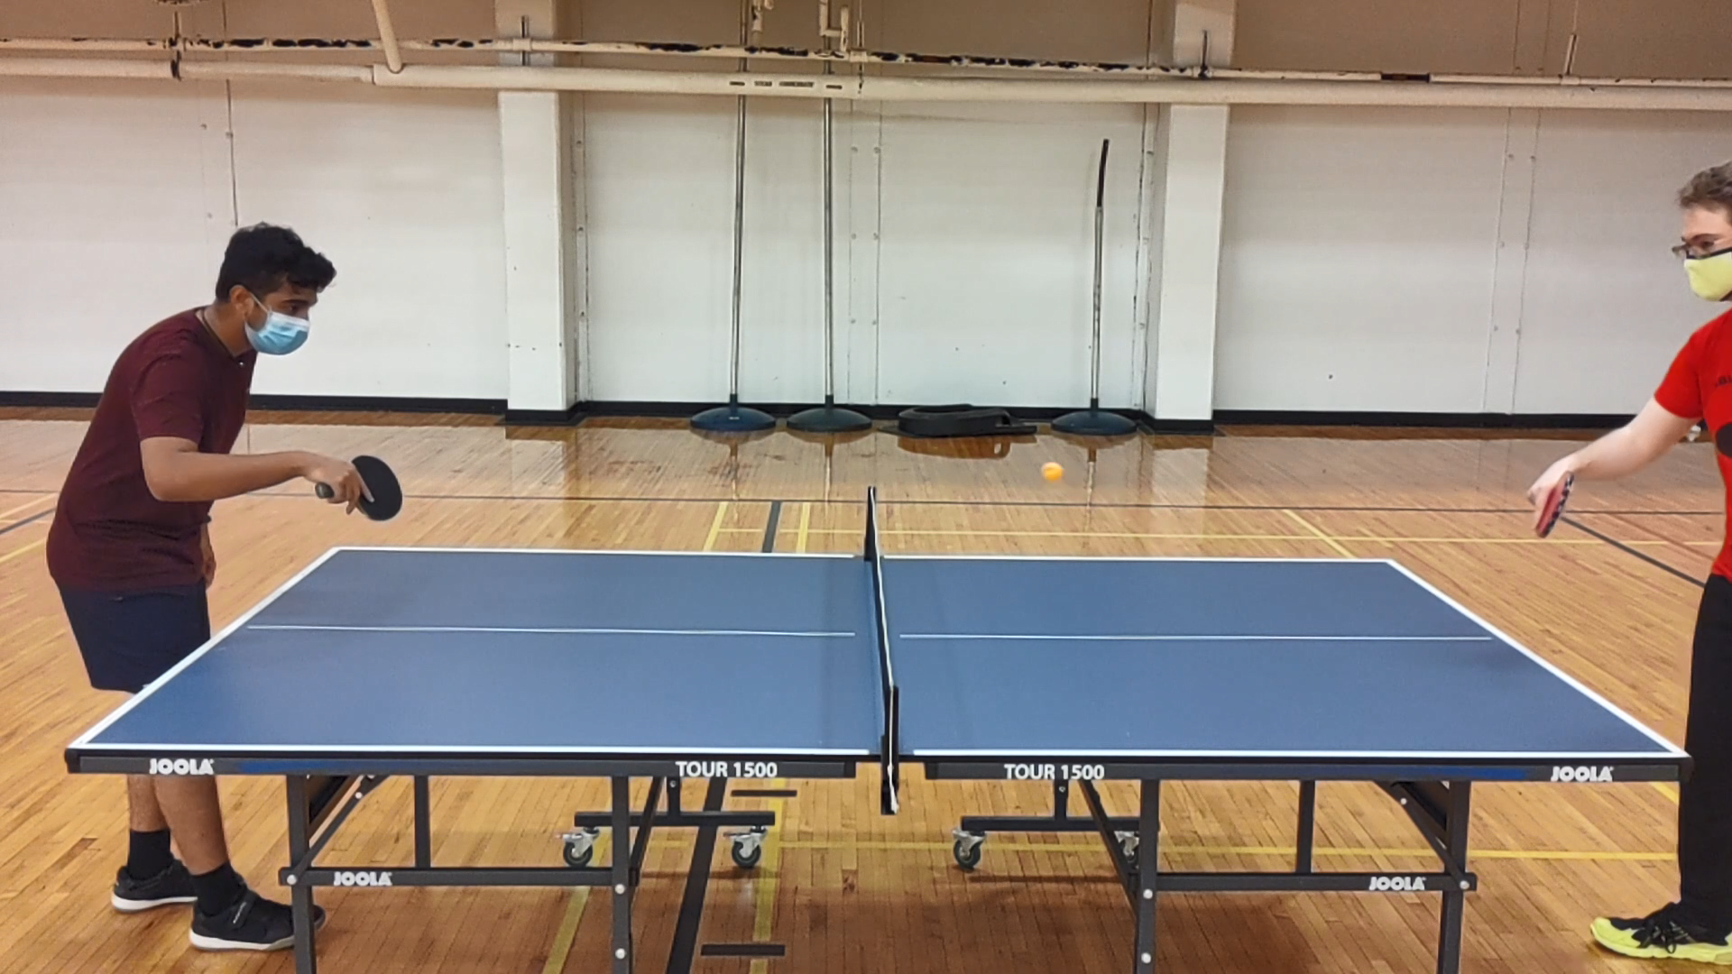

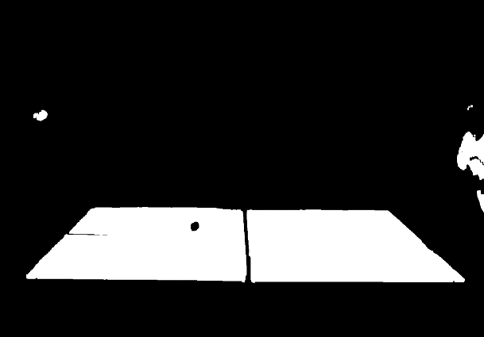
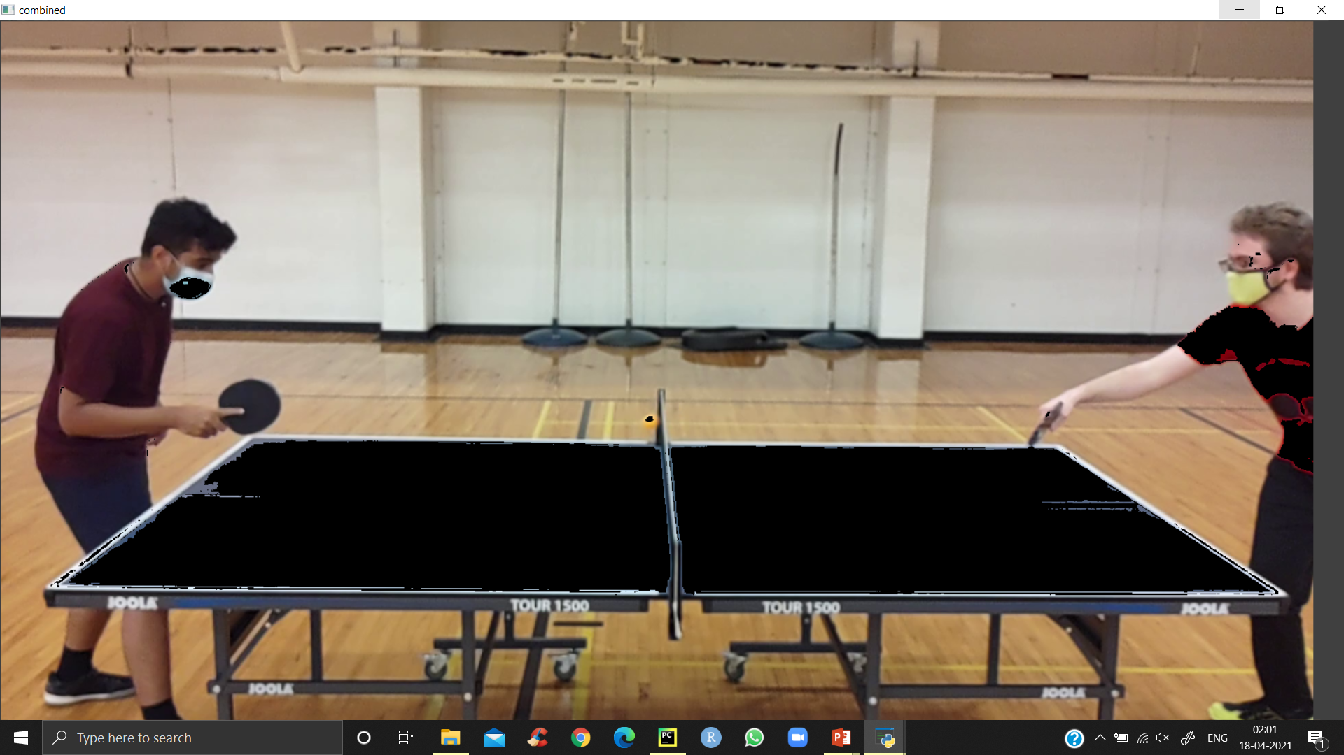
Step 2: Pre-processing
As a pre-step of table detection, in order to prevent false positives in all detection algorithms, using the first frame all initially white regions are detected and removed.
First, all colors are passed to HSV color space which enables working in a more continuous color space, unlike RGB.
A series of dilations and erosions were done to eliminate salt and pepper noise the image to only the features that were required.
Given below are the masks and combinations applied.
Initial Frame – No mask
Frame with mask on Ball applied
Frame with Mask on table applied
Combined representation of table and masked image

Slide 6
Step 3: Detecting the Ball
To detect the ball effectively, once the mask had been applied on the ball the following procedure is followed:
Detect all contours on the mask [Use cv2.findContours()]
If any contours are found, Find the centroid of the contour area. [Use cv2.moments() and calculate]
Write the coordinate to a list to maintain the history
To avoid False positives define the minimum radius rule [example. If radius > 2]
Display the center and the trail on the frame [Use cv2.line () and cv2.minEnclosingCircle() using the coordinates in step3 ]
The following components are visible in the adjacent image.
Red Spot – Center of the ball
Yellow Circle – Ball encircled
Green Trail – Path of the ball
The ball coordinates are also written to a list for evaluation of bounce.

Slide 7
Step 4 – Detecting Bounces
A bounce is an event that occurs on the table.
If we assume that the ball follows a parabolic path, the bounce is also the instance where two parabolas intersect (i.e) the common solution.
The following steps are followed to detect a bounce:
A parabola is fit to the points detected in real-time using an extrapolation (At least 3 points required)
If any point does not fit (Quadratic residue is high) the equation - ignore it as false positive for the first instance.
If more than one point fails to fit the equation in succession, fit a new parabola with last 3 points. (n, n-1, n-2)
If we are able to fit a parabola, consider (n-2) as the bounce pixel.
Detected Bounce point

Slide 8
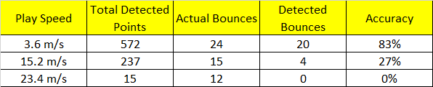
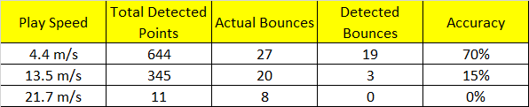
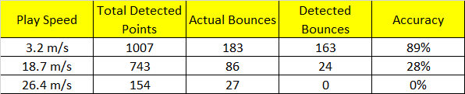
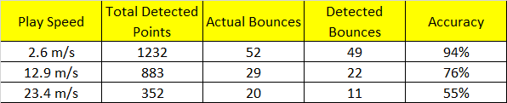
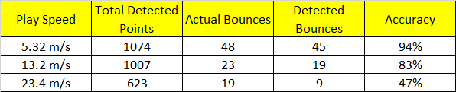
Discussion of Results
The Ball and Bounce detection were tested on different frame rates and camera resolutions in a DOE to evaluate effectiveness.
Resolution: 4K |Frame Rate: 30fps
Resolution: 1920 x 1080 |Frame Rate: 30fps
Resolution: 1920 x 1080 |Frame Rate: 60fps
Resolution: 1920 x 1080 |Frame Rate: 120fps
Resolution: 1280 x 720 |Frame Rate: 240fps

Slide 9
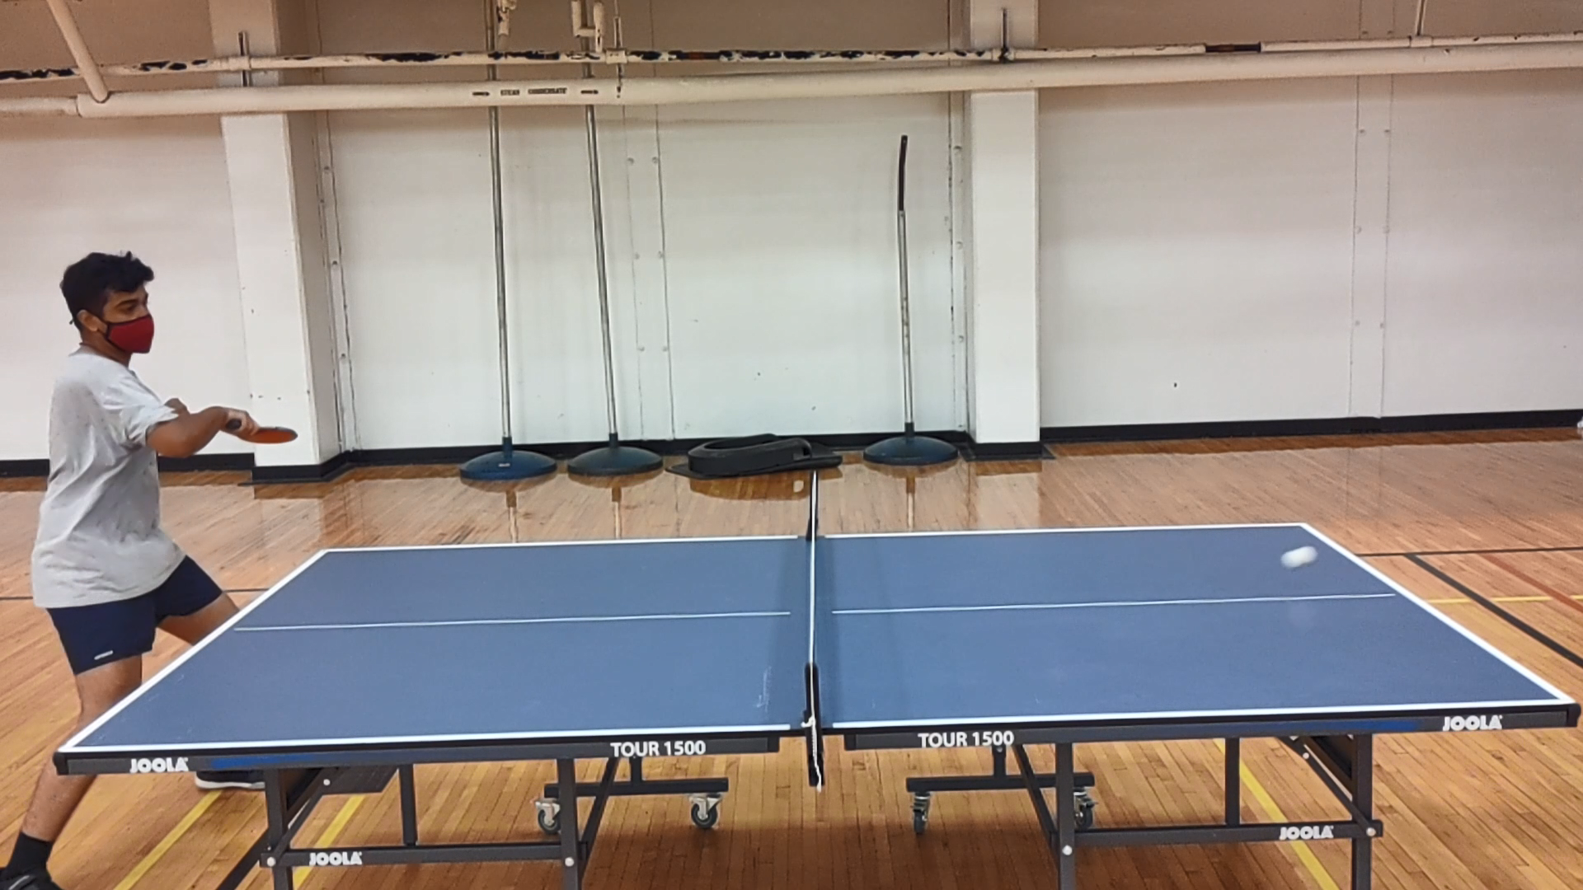
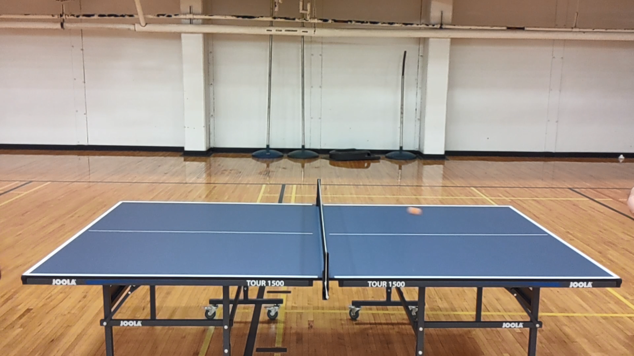
Challenges To Execution

Slide 10
Future Work and Possibilities
WTT IMPLEMENTATION VIDEO

Slide 11
Similar work

